Slide 1

Giving a Presentation
How to give a good presentation
School of Computing and Information
Department of Computer Science

Slide 2
Presentation Logistics
We’ll have 2 presentation sessions per day
15 minute talk
10 minutes Q & A
Submit all slides to Canvas by Thursday midnight
Preferred format: PDF (preferred), Powerpoint
Submit to the “Presentation Slides” link
Put title, name, and project on cover page (So your friends know who you are and where you worked)
Number your slides
Also submit “Presentation Question” by then

Slide 3
Presentation Questions
Purpose:
Focus presenter on one or more learning goals
Answer rate is a metric showing success of presentation
At least one multiple choice / fill-in-the-blank
Feel free to add supplementary questions
Add more questions to check audience understanding
You can even have survey questions to ask opinions
You can also have free form text questions
All questions will be added to TopHat before talk

Slide 4
Peer Review Logistics
Submit TopHat answers by Sunday midnight
Answers to the “presentation questions”
Answers to feedback questions
Feedback provided to presenter before next class
Feedback and answers will be attached to “Presentation Slides” grading feedback in the form of .xslx

Slide 5
Now let’s talk about giving a good talk

Slide 6
Outline
Why am I presenting in front of all these people?
How to structure my talk
Issues you want to avoid
Slide Design
Slide Delivery

Slide 7
Outline
Why am I presenting in front of all these people?
How to structure my talk
Issues you want to avoid
Slide Design
Slide Delivery

Slide 8
Why am I presenting in front of all these people?
You have experience worth sharing with your peers
You worked on unique topics, ideas, products
You worked for a unique organization
Could be …
Product design; Why was a certain tech used and not something else?
Software development methodology; How did you feel about it? Did it increase productivity?
A new interesting job category; How does it compare to SW developer? Did you like it?
Challenges you faced (technical, interpersonal, organizational); How you did you resolved them? What did you learn?

Slide 9
Why am I presenting in front of all these people?
To gain practice in giving a technical talk
Learn how to structure your ideas
Learn how to design slides effectively
Learn how to deliver your ideas impactfully
You also have an active role as a listener
In giving helpful peer reviews to your friend
Refer to the “Peer Review Tips” page: https://wonsunahn.github.io/Capstone_Spring2021/review_tips/

Slide 10
Why am I presenting in front of all these people?
NOT to report on your internship to your instructor
That purpose is already fulfilled by your report
Busy people are listening to you intently
Make it worth their time
Talk to your peers, not your instructor
Focus on the whys and hows
That’s where the interesting discussions happen
Compared to what I did, what I made, what I ate

Slide 11
Outline
Why am I presenting in front of all these people?
How to structure my talk
Issues you want to avoid
Slide Design
Slide Delivery

Slide 12

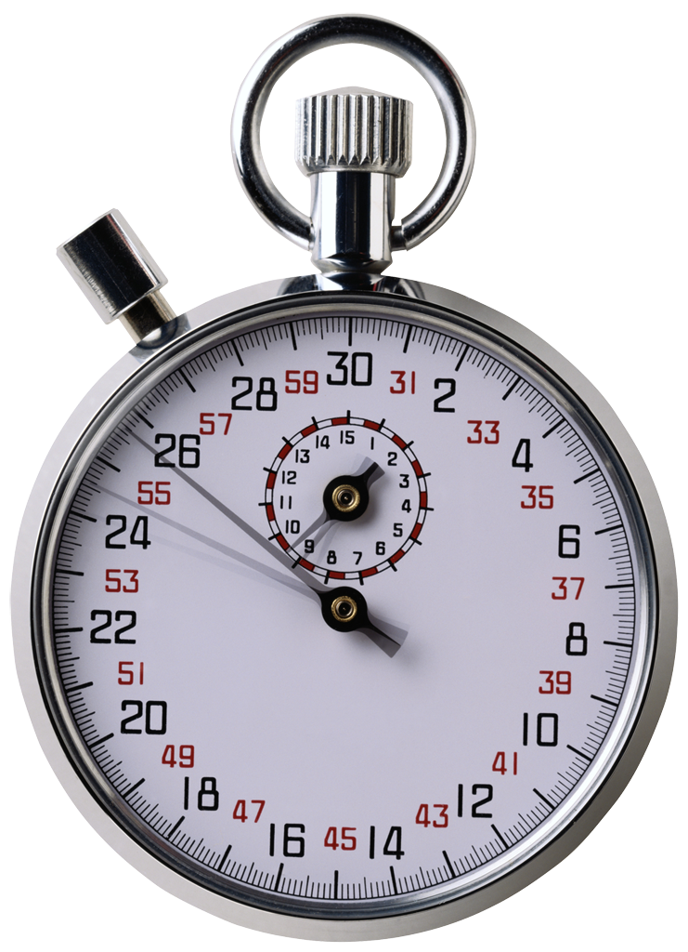
Structure your talk based on your audience and the time that you have
Your audience: Generally smart individuals
Computer Scientists? Yes
Knowledgeable about your area? Maybe
Knowledgeable about your problem? Probably not
Time is usually limited
Invited talk: < 1 hour
Conference talk: 20 minutes or so
Elevator talk: < 2 minutes
Your talk: 15 minutes
This is not a lot of time…
Bottom line: Your audience should learn something from your talk

Slide 13



That’s not a lot of time, how should I structure my talk to relate to these people?
This is a hard problem…
… with interesting applications…
… that builds on prior work…
Two sub-parts:
You solved a problem
You used neat technological advancements to do this

Slide 14
Think Big Picture and Context
Do not lose sight of the big picture
Audience should always know where you are taking them
Audience may need refocusing from time to time
Give context
Why are you telling me this? Where does it fit in?
Why did you make that choice? What were the constraints?
Was that choice successful? Why or why not?

Slide 15
Outline
Why am I presenting in front of all these people?
How to structure my talk
Issues you want to avoid
Slide Design
Slide Delivery

Slide 16
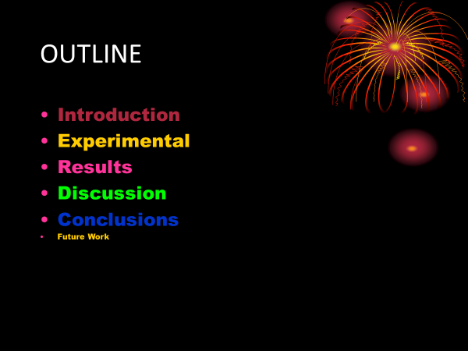
Admire my beautiful slide

Slide 17
Admire my beautiful slide
A slide is not abstract art – curb your enthusiasm
Fonts, colors, and style should be consistent
If not, the difference should convey a meaning
By the way, was that outline slide really necessary?
Most talks are structured that way – no information content

Slide 18
Look at my code, my code is amazing

Slide 19
Look at my code, my code is amazing
Hate to break it to you but …
Nobody wants to read your code
If you still feel it is helpful:
At least explain at a high level what the code is trying to do
Focus audience attention at the part that is interesting

Slide 20
My Code
This is my pseudocode for solving Hanoi towers:
void solve_hanoi(n, src -> dest, temp)
{
if (n == 0) return;
solve_hanoi(n-1, src -> temp, dest);
move(1, src -> dest);
solve_hanoi(n-1, temp -> dest, src); }
↑ ↑ ↑ ↑ ↑ ↑ ↑ ↑ ↑ ↑ ↑ ↑ ↑ ↑ ↑ ↑ ↑ ↑ ↑ ↑ ↑ ↑ ↑ ↑ ↑ ↑ ↑ ↑ ↑
Warning: Example of a bad slide. Do not imitate.

Slide 21
Towers of Hanoi: Recursive Solution
src
temp
dest
Move all disks at src → dest
With the help of temp
Rule: disks must always be stacked smallest → largest
Move n-1 disks into temp
Recursive formulation as original problem, just with n-1 disks
Move 1 disk into dest
Move n-1 disks into dest
Again, n-1 version of same problem

Slide 22
Towers of Hanoi: Recursive Solution
Recursive solution for the Hanoi towers:
void solve_hanoi(n, src -> dest, temp)
{
if (n == 0) return;
solve_hanoi(n-1, src -> temp, dest);
move(1, src -> dest);
solve_hanoi(n-1, temp -> dest, src); }
Solve moving n-1 disks with the power of recursion!

Slide 23
I am a math whiz

Slide 24
I am a math whiz
Well guess what. Many are not.
Translate math to plain English whenever you can
At least highlight what matters, and what is the take home message
Increasing the elements of decreases the value of the function

Slide 25
Just read my text
Proof sketch:

Slide 26
Just read my text
Then why am I listening to you?
Having too much to read can interfere with listening
Did you know? Reading and listening exercise the same part of the brain

Slide 27
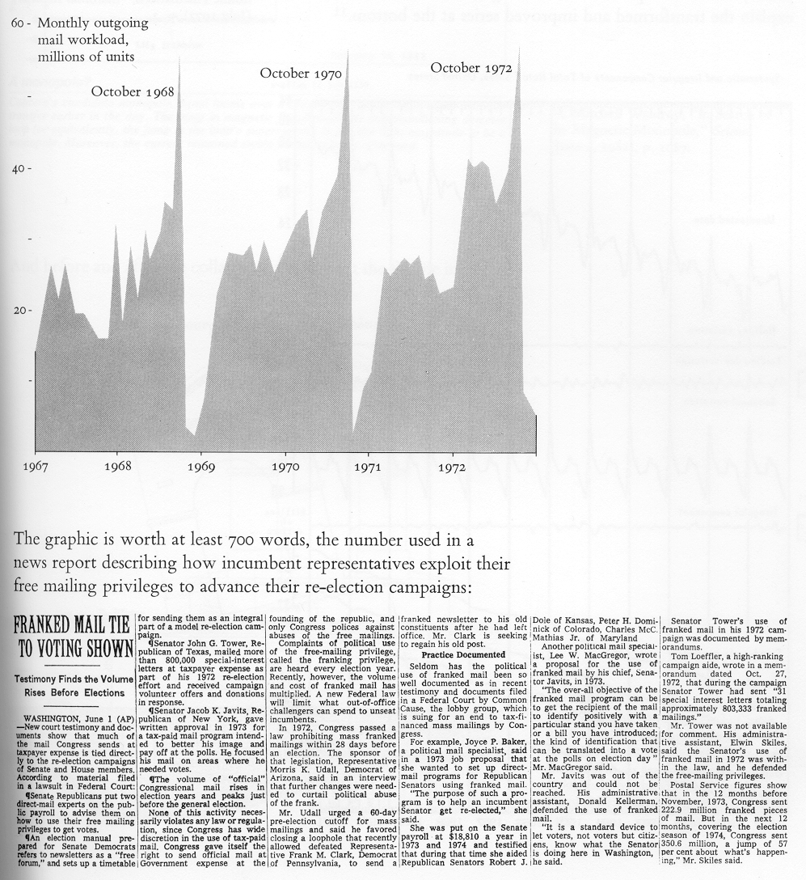
A picture is worth a thousand words But only if you explain it!
Don’t leave a picture hanging there and expect your audience to interpret it
If you have something on your slide that you don’t explain, it is just noise.

Slide 28
A picture is worth a thousand words But only if you explain it!
Put in graphical cues to focus attention
Point to the figure and explain each part
Interpret the figure on behalf of the audience
Election Months
Number of letters sent by congress

Slide 29

Acronyms and jargons are useful But only if you explain them!
IMHO, ARE = ADIH. TBH, FUBAR & 2M2H.
Translated: In my humble opinion, an acronym rich environment is another day in hell. To be honest. Its f***ed up beyond all recognition and too much to handle.

Slide 30
Outline
Why am I presenting in front of all these people?
How to structure my talk
Issues you want to avoid
Slide Design
Slide Delivery

Slide 31

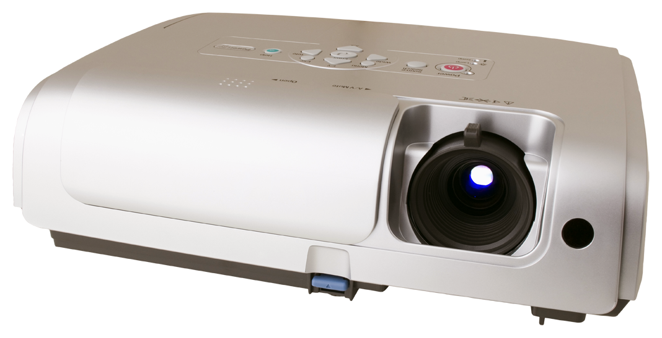
It’s not just what you say, but how you say it
Body language says a lot
Make eye contact with your audience
Corollary: Face your audience
Some movement is good
Have a measured pace
Present one primary idea per slide
Use slide titles to convey take-away message
Refer to every item on the slide
If you don’t, better to remove that item
Avoid reading from your slides
But put all important information there

Slide 32
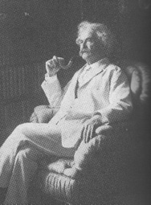
Practice, Practice, Practice
Practice makes better
Alone: Work on your “script,” smooth out transitions
Peer group: Get used to other people being around
Broader population: Assess outsider comprehensibility
It takes three weeks to prepare a good ad-lib speech
- Mark Twain

Slide 33
Let’s Critique some Real Slides
From anonymous previous Capstone students

Slide 34
API With Purchase Document
Response

Slide 35
Projects
Food and Beverage / Retail Software
Software: Android Studio
Server: MySQL
Worked on UI and worked to add functionality and new features
Fix bugs
Lib Project
Work on developing library that would send information to various hardware devices
Work with code on both sides to tweak it so it follows the specs
Actually released lib to other software houses for internal testing

Slide 36







Technologies

Slide 37


Project Overview
VersionOne Migration to Jira
Why?
VersionOne is slower and inefficient
VersionOne is more expensive
Jira is compatible with other technologies that PNC uses
PNC originally migrated from Jira to VersionOne manually, which resulted in the loss of images, conversations, and time.
Our Task
Create a self service migration tool to automate the process
Ensures that all information is carried in this migration process, such as conversations, images, etc.
Notes:
VersionOne is more expensive because it requires the purchase of the entire package, in which PNC may not want to use all of the functionalities. In Jira, you can select which functionalities to purchase.
Jira was under the same company of other technologies that PNC uses, such as Mattermost, Confluence, etc. (Atlassian?)

